Slide 1

Sales-shipment Analysis
By Team Tech Orcas

Slide 2

Motivation
Recognizing the importance of customer feedback and operational transparency, we've created a platform that empowers users with order tracking capabilities and feedback system and provides staff with robust order management tools.

Slide 3
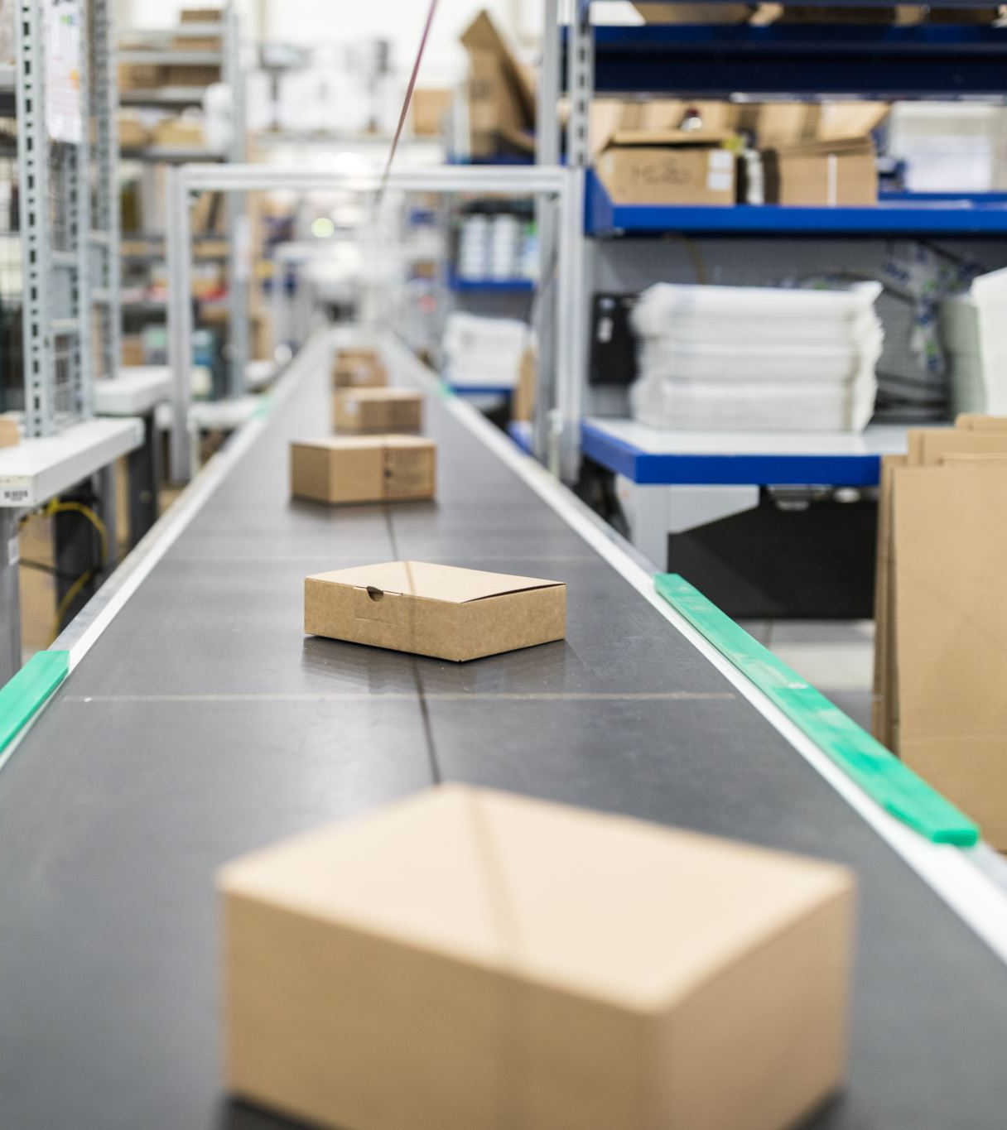
Product Overview
Embarking on a transformative journey, we created a sophisticated end-to-end application designed to revolutionize the way sales and shipping details are analyzed and managed. This application is being crafted to function as an all-encompassing platform that caters to both customers and staff, with the aim of substantially improving the efficiency of order processing and the overall delivery experience. It encompasses two primary modules - operational and analytical. On the operational front, the application is geared towards capturing valuable customer feedback on their orders and providing personalized product recommendations through customer dashboards. The analytical component is engineered to dissect data dynamically, uncovering pivotal insights such as time-based order volumes, the status of deliveries, product categories, and geographic sales distribution, all of which are crucial for informed strategic planning.

Slide 4
DATA SOURCE
Data Source:- E-Commerce Sales Dataset Link
Mockaroo: https://www.mockaroo.com/ (For names, addresses, Phone Numbers and Emails)
CHAT GPT When required for cross checking

Slide 5
Application Design
For the development of our application, we've employed a robust suite of technologies:
Python: Serves as the core programming language.
MySQL Workbench: Our chosen database design tool, allowing for sophisticated ERD (Entity-Relationship Diagram) modeling to structure our database efficiently.
PyQt Designer: Enhances our ability to craft intuitive user interfaces for a seamless user experience.
Our application's functionality is further enriched by integrating several additional Python libraries:
Pandas.
Sklearn
PyQt5

Slide 6
ETL Process
We used Python and
MS Excel to clean the data
The primary coding for the project is accomplished using Python
SQL queries executed through Python interfaces
Others executed natively in the SQL platform for data modification checks.

Slide 7
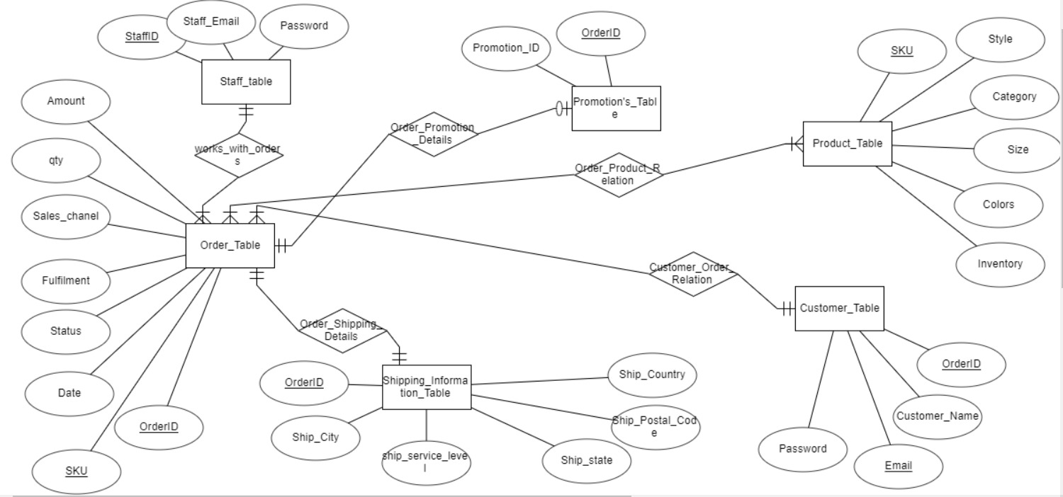
ER Diagram

Slide 8
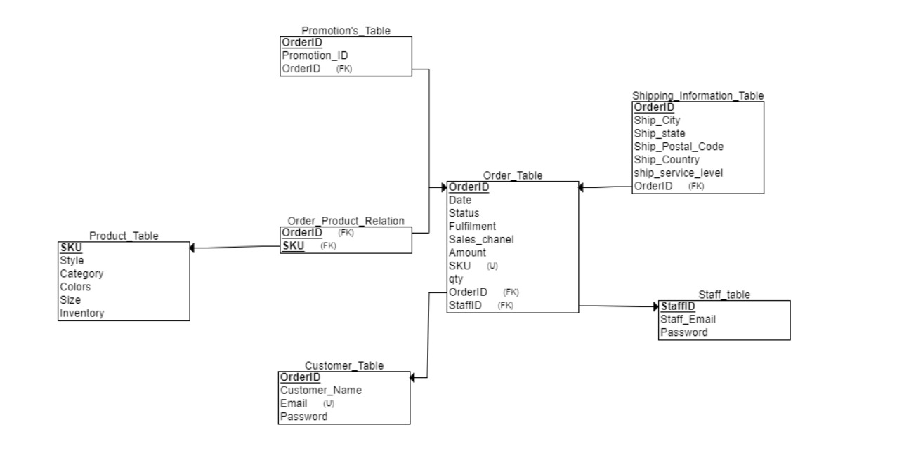
Relational Schema
Normalized form
Maintained Data Integrity
Robust Data Architecture: Our database is engineered with a focus on robust data architecture, ensuring optimal performance and scalability.
Operational Data- we have latest 30 days of data
For analytical – we have historical data of last 3 months

Slide 9
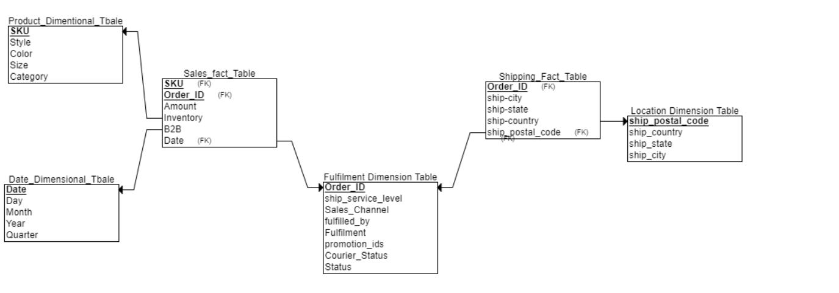
Star Schema
Slicing Operations
Dicing Operations
Drill Down Operations
Granularity Maintained
ETL :-From operational tables and python and SQL.

Slide 10
Operational Module - Customer
The operational module of the application is a customer-centric interface designed to enhance the user experience post-purchase. It includes features that allow customers to:
Track Orders: Customers can follow the journey of their purchase from warehouse to delivery, with real-time updates on the progress of their orders.
Provide Feedback: A feedback system is integrated into the order tracking page, enabling customers to rate their satisfaction with the product and delivery service. This feedback is vital for continuous improvement.
Personalized Recommendations: The system analyzes past purchases and browsing behaviors to offer individualized product suggestions, encouraging repeat business and increased customer engagement.

Slide 11

Operational Module- Staff
For staff, the operational module equips them with tools to:
Update Order Status: If there are exceptions such as delays, damages, or lost items, staff can update the order status to keep customers informed.

Slide 12
Analytical Module
The analytical dashboards will provide a comprehensive overview of sales and shipping metrics, crucial for driving business growth and strategic decisions. Through the visualization of data, these dashboards offer insights into customer purchasing behaviors, product performance, and logistical efficiency.
Business Questions:
Trend Analysis: What are the trends in order and SKU counts over time, and how do these correlate with sales and marketing activities?
Order Status Monitoring: How does the distribution of order statuses (shipped, pending, canceled) vary over time, and what can be inferred about the efficiency of the fulfillment process?
Product Performance: Which product categories are performing the best in terms of order count, and how does this align with inventory levels?
Geographic Sales Insights: Which states are generating the most sales, and how might this influence regional marketing strategies and inventory distribution?
Customer Preferences: Based on the frequently purchased products and categories, what are the emerging customer preferences, and how can this information be used to tailor future product offerings?
These dashboards empower the business with data-driven insights to fine-tune operations, customize marketing efforts, forecast demand, and enhance customer service.

Slide 13

We will look at the Live demo now!!

